Slide 1

Building & Mining Knowledge Graphs
(KEN4256)
Lab 2: Exploring knowledge graphs - DBpedia & Wikidata

Slide 2
DBpedia
https://wiki.dbpedia.org
Notes:
Explore Maastricht page (follow links)
Show different RDF formats
End on cliffhanger :) can’t answer question because information not linked

Slide 3

Crowdsourced community effort to extract structured content from information created in various Wikimedia projects
Structured information resembles an open knowledge graph (OKG) which is available for everyone on the Web
English version of the DBpedia knowledge base describes
4.58 million things,
including 1,445,000 persons, 735,000 places , 241,000 organizations etc.
Localized versions of DBpedia in 125 languages
8.8 billion facts, large-scale-cross-domain knowledge graph

Slide 4
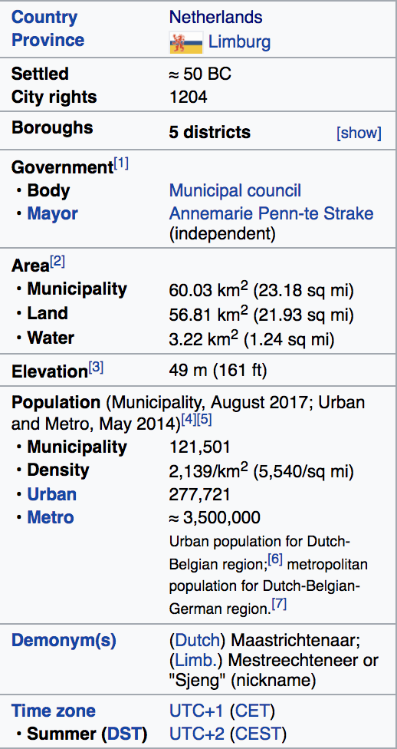
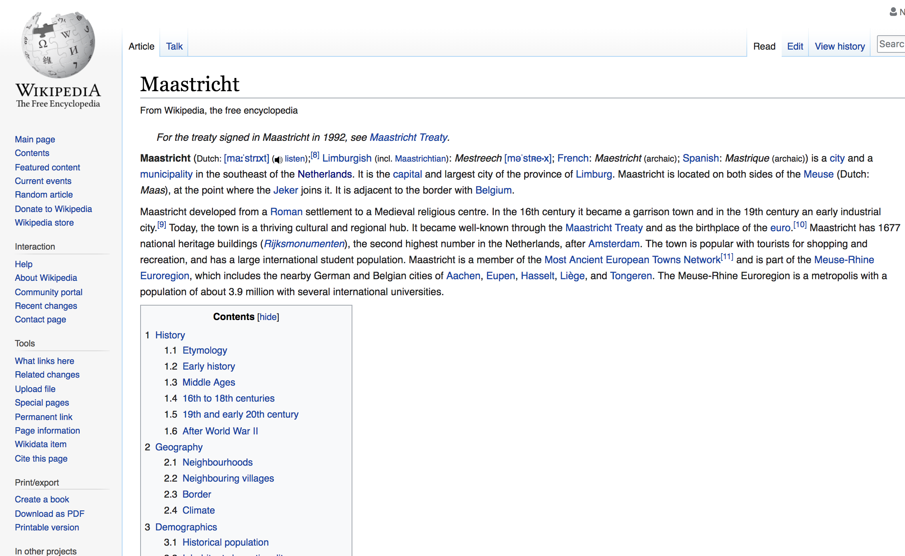
Notes:
Show how information is structured on Wikipedia vs DBPedia
Show Wikipedia code to students

Slide 5
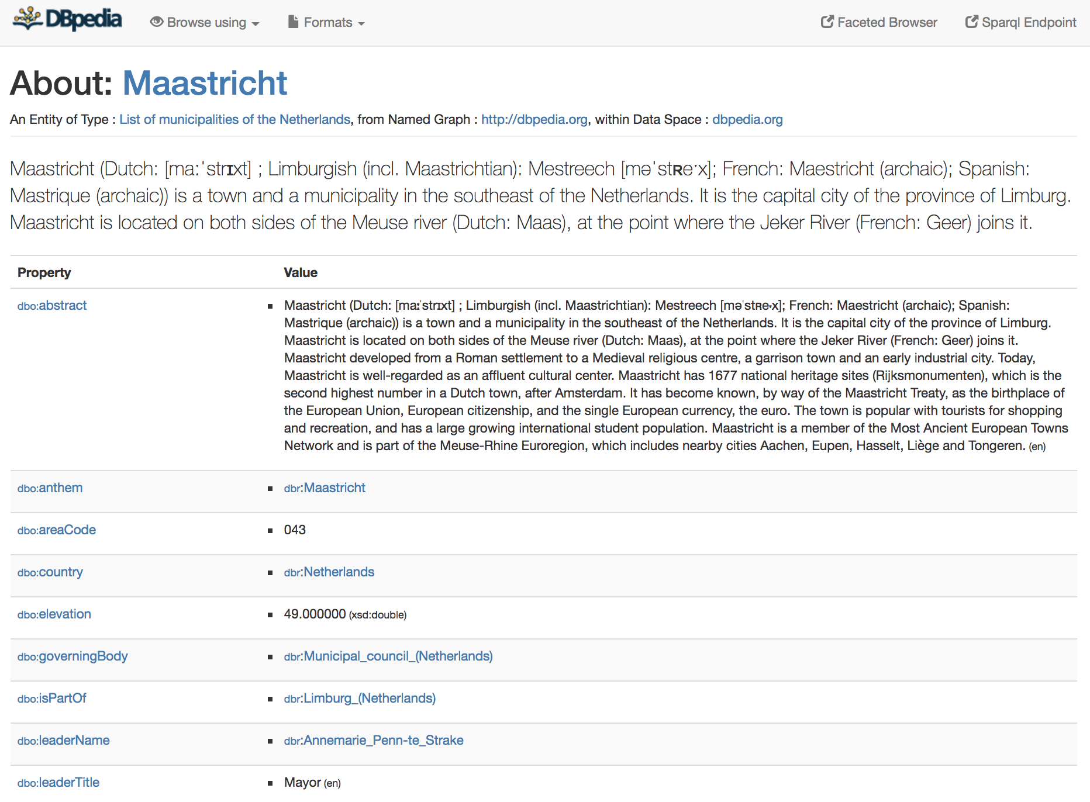
http://dbpedia.org/page/Maastricht
Notes:
Recap linked data principles and explain how this page exemplifies those principles (http://dbpedia.org/page/Maastricht)
Show different RDF triple formats (NTRIPLES, TURTLE, JSON, XML)
Explore links from Maastricht page to discover new information

Slide 6
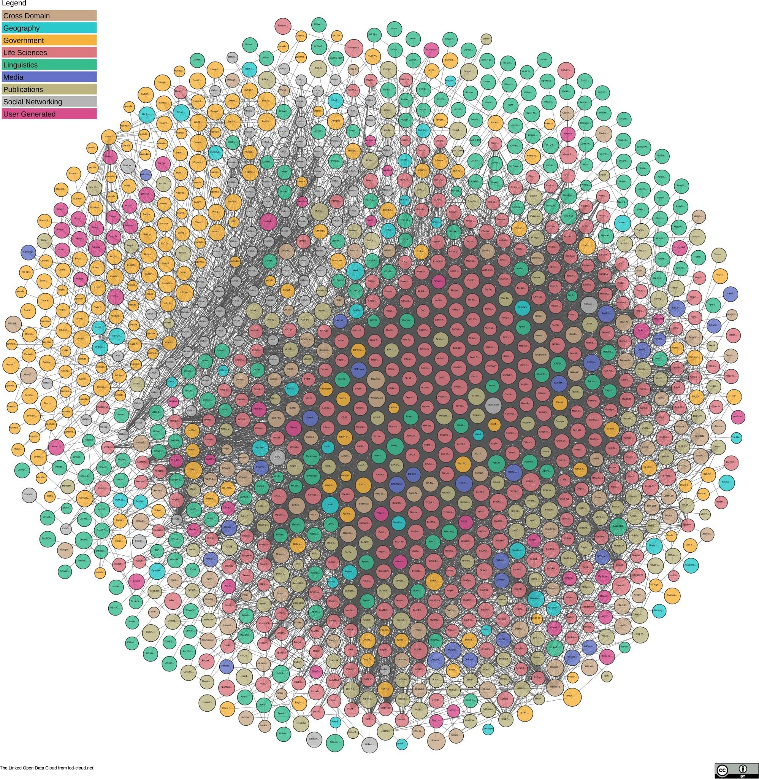
https://lod-cloud.net/
1,224 datasets
with 16,113 links
(as of June 2018)
Notes:
DBpedia is nucleus of LOD

Slide 7
Link between DBpedia and WorldBank Countries
PREFIX wb: <http://worldbank.270a.info/classification/country/>
PREFIX owl: <http://www.w3.org/2002/07/owl#>
PREFIX db: <http://dbpedia.org/resource/>
wb:AD owl:sameAs db:Andorra . wb:AE owl:sameAs db:United_Arab_Emirates . wb:AF owl:sameAs db”Afghanistan .
Notes:
https://github.com/csarven/worldbank-linkeddata/blob/master/data/worldbank-sameAs-dbpedia_countries.nt

Slide 8
Relfinder
Find relationships between entities http://www.visualdataweb.org/relfinder.php
Between two people
Between two organisations
Between a person and an organisation
Between two things which are neither people nor organisations
Between a person and any entity which is neither a person nor an organisation
Between an organisation and any entity which is neither an organisation nor a person

Slide 9
The power of knowledge graphs
From the simple questions...
Musicians who were born in Berlin
To very complex!
soccer players, who are born in a country with more than 10 million inhabitants, who played as goalkeeper for a club that has a stadium with more than 30.000 seats and the club country is different from the birth country

Slide 10
Wikidata
https://query.wikidata.org/
Notes:
Explore Maastricht page (follow links)
Show different RDF formats
Test / task?
End on cliffhanger :) can’t answer question because information not linked

Slide 11

Collaboratively edited knowledge graph (anyone can contribute)
Different from DBpedia (DBpedia relies on Wikipedia updates - it provides only Wikipedia information. Wikidata can include other information)
Wikidata also places emphasis on provenance (where does this information come from and how was it generated?)
Google’s knowledge graph was previously powered by Freebase KG (now shutdown). Information from Freebase was transferred to Wikidata which built upon this knowledge. Large part of Google KG is Wikidata.
54,346,344 entities!

Slide 12
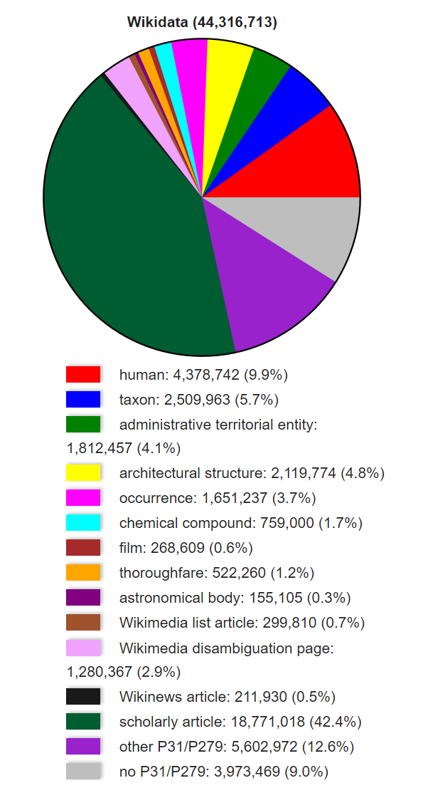
What’s inside?

Slide 13
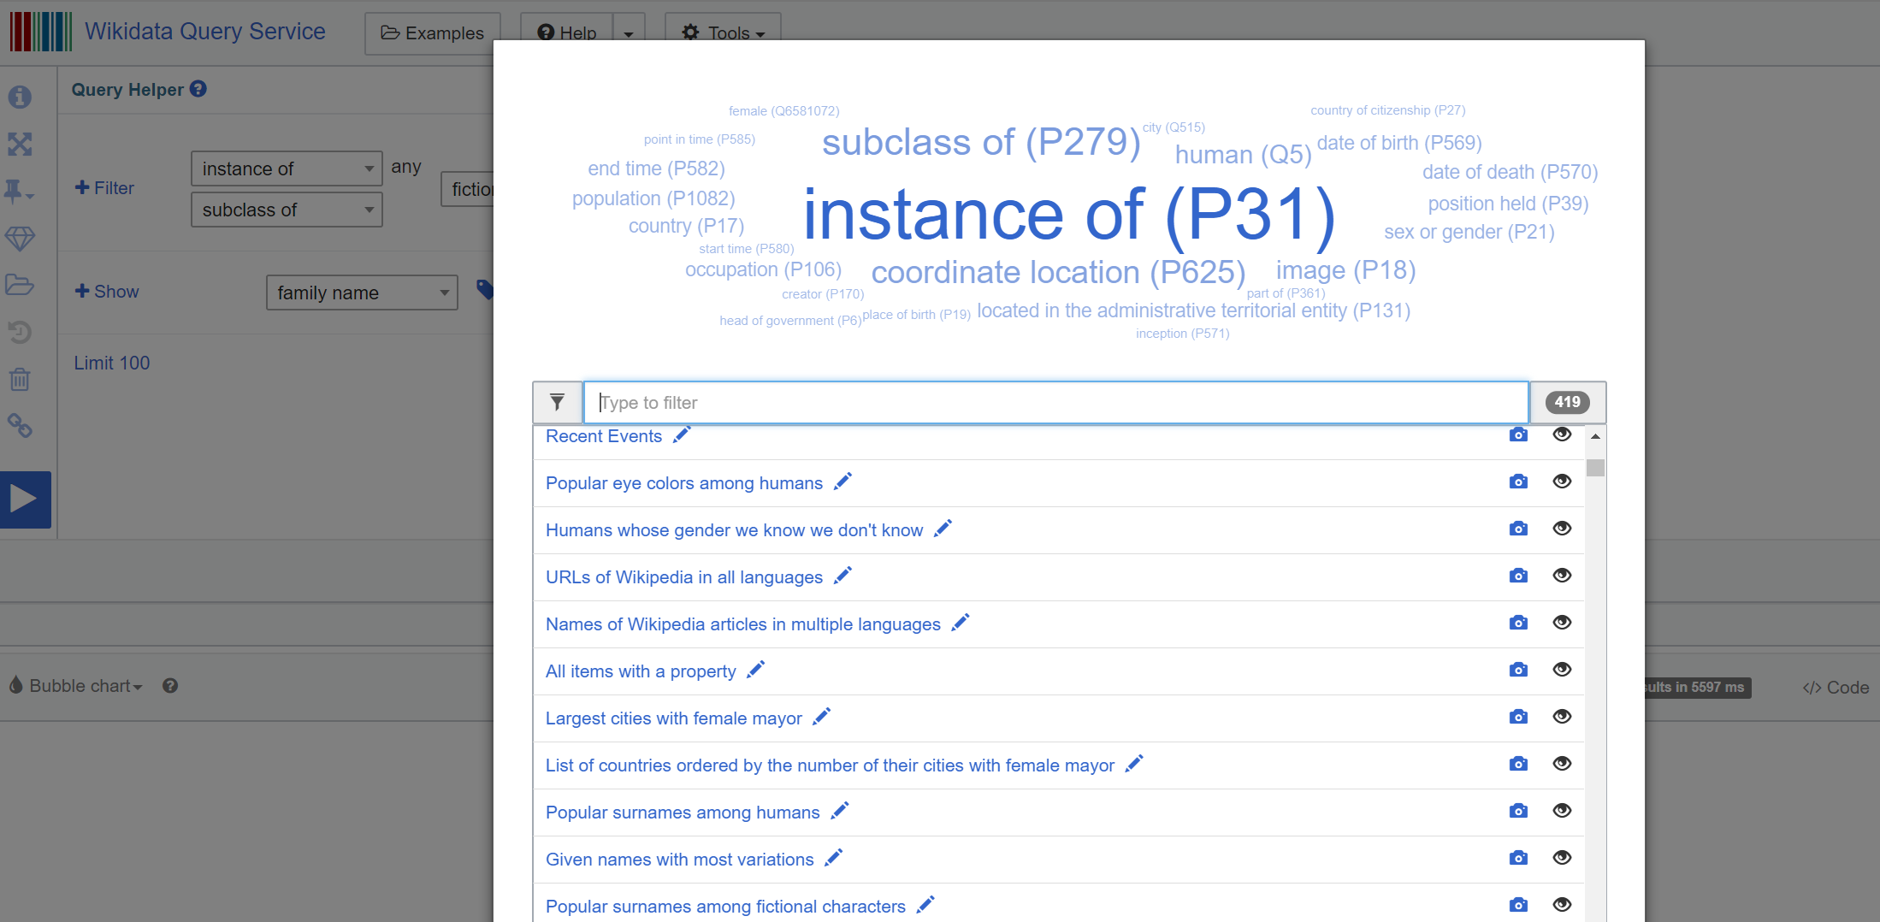
Exploring Wikidata
Look at example queries [10min]

Slide 14
Exploring Wikidata
Can you find these?
http://graftie.com/
A list of movies in which Tom Cruise plays a role
The list of directors for movies in which Tom Cruise plays a role
List of directors for drama films in which Tom Cruise plays a role
Pick any entity you want to know something about and use Graftie to find relations that it has to other entities that you did not know about.

